Slide 1
FLOOD MONITORING AND EARLY WARNING SYSTEM

Slide 2
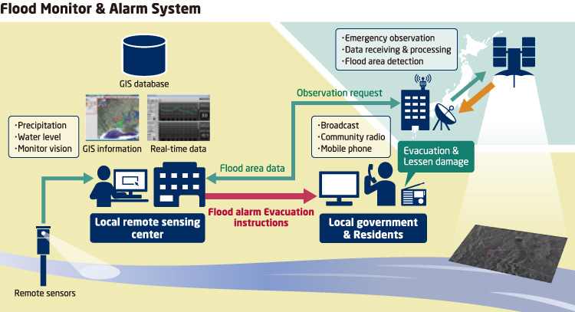
HOW MODEL WORKS IN REAL WORLD
Internet of Things (IoT) based techniques and applications implemented for efficient flood monitoring and an early warning system and it is observed that in future, the combination of IoT and Synthetic Aperture Radar (SAR) data may be helpful to develop robust and secure flood monitoring and early warning system that provides effective and efficient mapping during natural disasters. The IoT based projects that can help collect data from sensors are an added advantage for researchers to explore in providing better services to people. These systems can be integrated with cloud computing and analyzing platforms. There have been many systems proposed based on analog technology to web-based and now using mobile applications. Further, alert systems have been designed using web-based applications that gather processed data by Arduino Uno Microcontroller which is received from ultrasonic and rain sensors. Additionally, the machine learning based embedded systems can measure different atmospheric conditions such as temperature, moisture, and rains to forecast floods by analyzing varying trends in climatic changes.

Slide 3
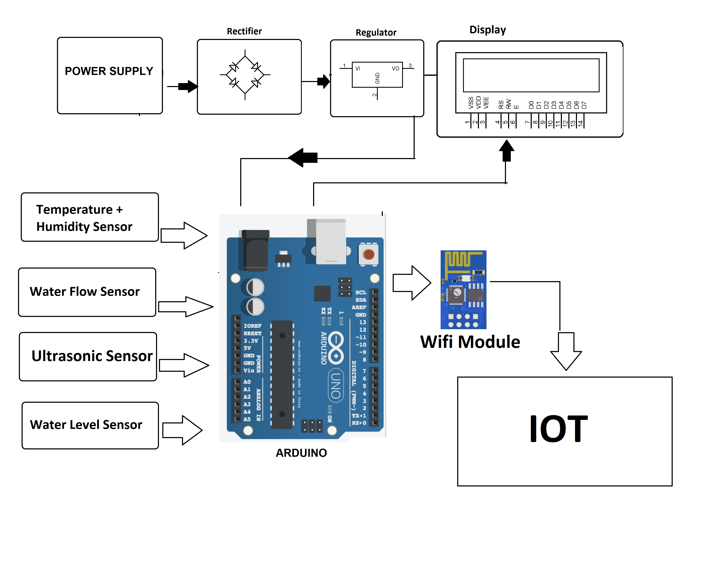
BLOCK DIAGRAM

Slide 4
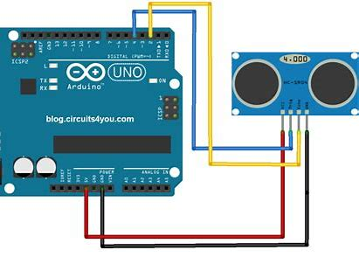
ULTRASONIC LEVEL SENSOR WITH MICROCONTROLLER(Arduino)
Ultrasonic sensors are a vital component of modern flood detection and alert systems. As they utilize high-frequency (ultrasonic) soundwaves to calculate the distance to a remote object without physically touching it, they can be used to create systems that reliably determine wave height and water levels at much lower installation and maintenance costs.
ultrasonic senor can be used with all microcontrollers like Arduino that
module has four pins: VCC, GND, Trig and Echo.
We power the module with 5 volts and GND to the Arduino UNO. The trigger pin and Echo pin are the input and output pins so they have to be connected to the input and output pins of the Arduino UNO. So to measure the distance we first of all set trigger pin to “high” for 10 micro seconds and then set to “low”.

Slide 5
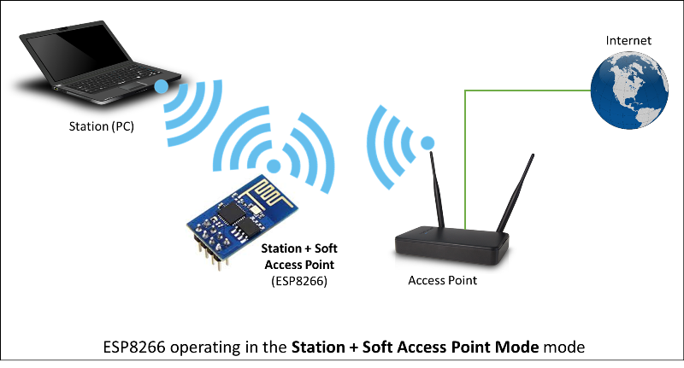
WIFI MODULE
ESP8266WiFi Module is a self contained SoC with integrated TCP/IP protocol stack that can give access to your WiFi network
Arduino to a logic high of 3.3 volts on the ESP8266 module. Again, the ESP8266 is specified with 3.3V logic, so connecting the module’s receive line directly to the Arduino’s transmit line could damage the device. We do not need to shift levels on the ESP8266’s transmit line because the module’s 3.3V logic high is a high enough voltage to also register as a logic high on the Arduino.

Slide 6
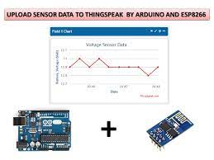
SOFTWARE DETAILS
The software requirements used in the system design are Arduino IDE . The Arduino IDE is an integrated development environment designed to program the Arduino microcontroller. It is an open platform for some addition add-on boards such as .The embedded C is used for supporting the embedded device. In this system the sensors relate to the device are connected to observe the state of flood detection in the system and programmed to warn the surrounding environment immediately.
Step 1: Sign up for ThingSpeak First, go to https://thingspeak.com/ and create a new free Mathworks account if you don’t have a Mathworks account before.
Step 2: Sign in to ThingSpeak Sign in to ThingSpeak using your credentials and click on “New Channel”. Now fill up the details of the project like Name, Field names, etc. Here we have to create four field names such as Humidity, Temp
Step 3: Record the Credentials . Select the created channel and record the following credentials. ➢ Channel ID, which is at the top of the channel view. ➢ Write an API key, which can be found on the API Keys tab of your channel view

